Slide 1

NOVAPAY
AI-Powered Fraud Detection
for Cross-Border Payments
Predicting fraudulent transactions with machine learning — from raw transaction logs to a production-ready Random Forest classifier.
Data Science Portfolio Project
Random Forest • scikit-learn • SMOTE • 11,400 Transactions
NovaPay Fraud Detection | 01

Slide 2




The Business Problem
Cross-border remittances move fast — fraud detection has to move faster.
Global exposure
Multi-channel risk
Cost of missed fraud
NovaPay processes remittances across the US, Canada and the UK, in 9 currencies — each corridor with its own risk profile.
Transactions arrive via web, mobile and ATM channels, each with different fraud signatures and device trust levels.
Undetected fraud drives direct financial loss, chargebacks, and regulatory exposure under KYC obligations.
Project Objective
Build a supervised classification model that flags fraudulent transactions in real time using behavioral, device, and transaction-level signals — maximizing recall on fraud without overwhelming analysts with false positives.
NovaPay Fraud Detection | 02

Slide 3


Dataset Overview
nova_pay_combined.xlsx — real-world-style transaction log with device, behavioral and KYC signals.
Target
is_fraud
11,400
26
9
3
Binary classification
Transactions
Raw Features
Currencies
Channels
Feature Groups
Identity & context: customer_id, home_country, source/dest currency, channel, timestamp
Transaction: amount_src, amount_usd, fee, exchange_rate_src_to_dest
Device & network: device_id, new_device, ip_address, ip_country, ip_risk_score, device_trust_score, location_mismatch
Behavioral / risk: kyc_tier, account_age_days, chargeback_history_count, risk_score_internal, txn_velocity_1h, txn_velocity_24h, corridor_risk
NovaPay Fraud Detection | 03

Slide 4


Data Cleaning & standadarzing
Real-world data is messy — inconsistent labels, missing values, and mixed types all had to be resolved before modeling.
Missing Values Handled
Field | Missing | Strategy
amount_usd | 305 | Recomputed via FX rate
fee | 295 | Median fee by channel
device_trust_score | 295 | Column mean
kyc_tier | 300 | Mode imputation
timestamp / ip_address | ~30 | Row-level drop (residual)
Feature Engineering
Extracted year, month, day, hour, day_of_week and is_weekend from timestamp
Binned account_age_days into 5 tenure buckets (<30d … >1yr)
Binned amount_usd into 6 transaction-size tiers
Binned ip_risk_score into 6 risk tiers for interpretability
Label Inconsistencies Standardized
channel: "weeb", "WEB" → web | "ATm", "MOBILE" → normalizedkyc_tier: "standrd" → standard, "enhancd" → enhancedhome_country: "Us", "US" → us (lower-cased & trimmed across text fields)
Label-encoded all categorical fields (channel, currencies, kyc_tier, etc.)
Standardized 12 numeric columns with StandardScaler
NovaPay Fraud Detection | 04

Slide 5

Where Fraud Concentrates: Channel & Segment
Exploratory analysis across 11,400 cleaned transactions surfaced clear segment-level fraud patterns.
Transaction Volume by Channel
Fraud Rate by Channel
Key Insight
Mobile is the dominant channel by volume (55%), but WEB Have the highest number of fraud — a strong signal that most fraud come from web site
NovaPay Fraud Detection | 05

Slide 6
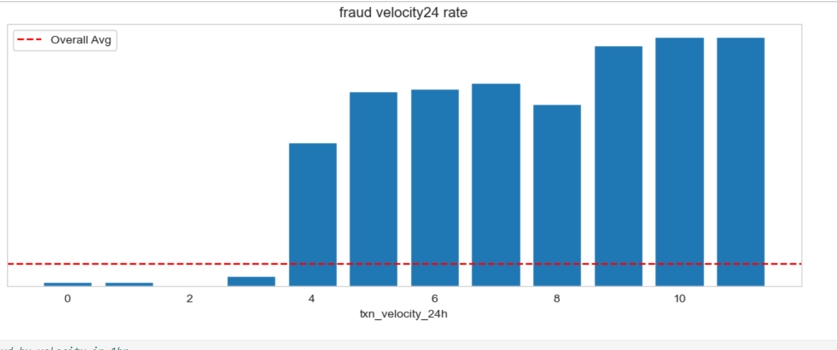

The Strongest Signal: Transaction Velocity
Fraud Rate by 24h Transaction Velocity
Key Insight
At 3 or fewer transactions in 24 hours, fraud is rare (≤4%). At 4+ transactions, fraud rate jumps to 58%–100%. The same pattern holds for 1-hour velocity — velocity features are the single most predictive signal in the dataset.

Slide 7
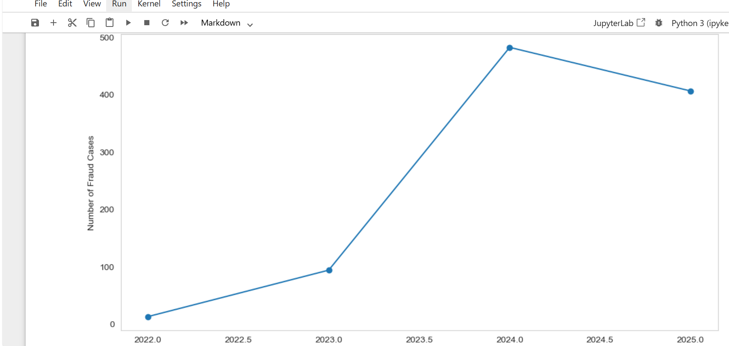
Risk Compounds with Amount, Time & Account Age
Fraud yearly trend
Fraud Rate by Hour of day
Key Insights
Yearly fraud trend we can see that 2024 have highest fraud transaction records.
NovaPay Fraud Detection | 07

Slide 8
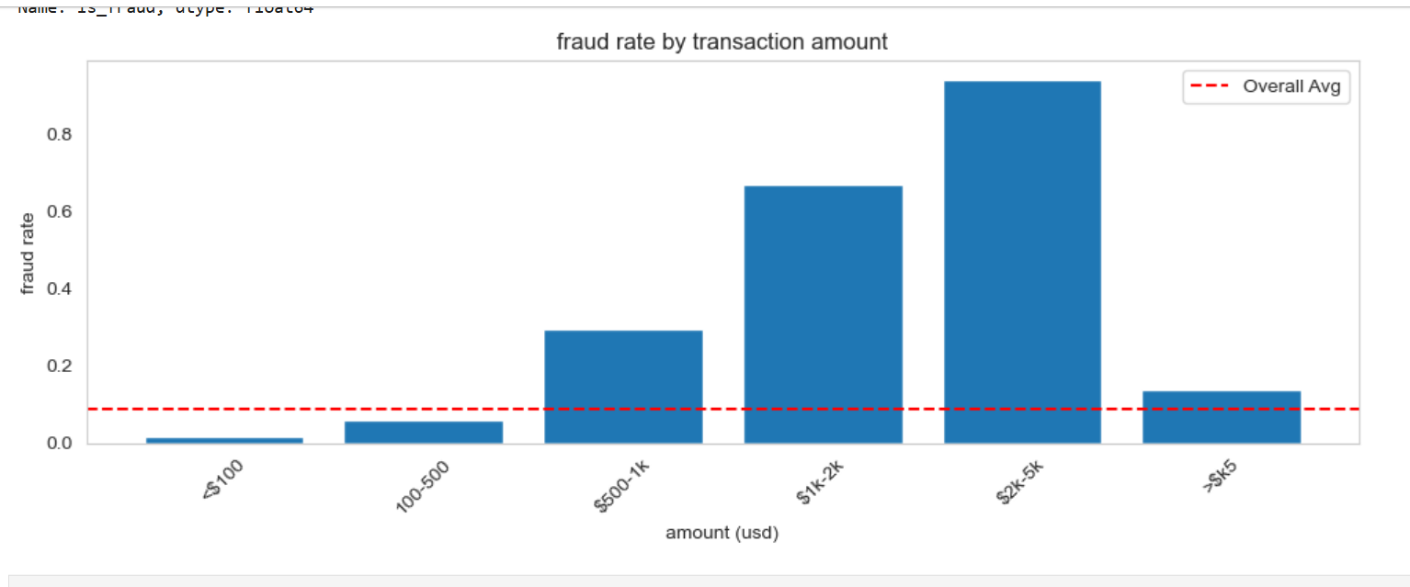
Fraud Rate by Transaction Amount
Key Insights
Amount: fraud risk rises steeply through $2k–$5k (94%), then drops for >$5k transactions — likely because very large transfers face stricter manual KYC review.

Slide 9
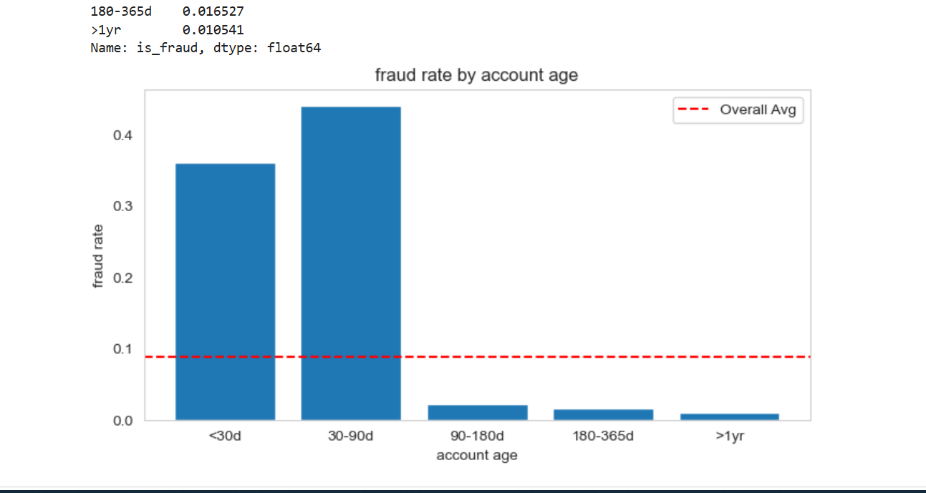
Fraud Rate by Account Age
Key Insights
: accounts under 90 days old are responsible for the large majority of fraud; risk falls below 2% after 90 days.Time of day
7

Slide 10
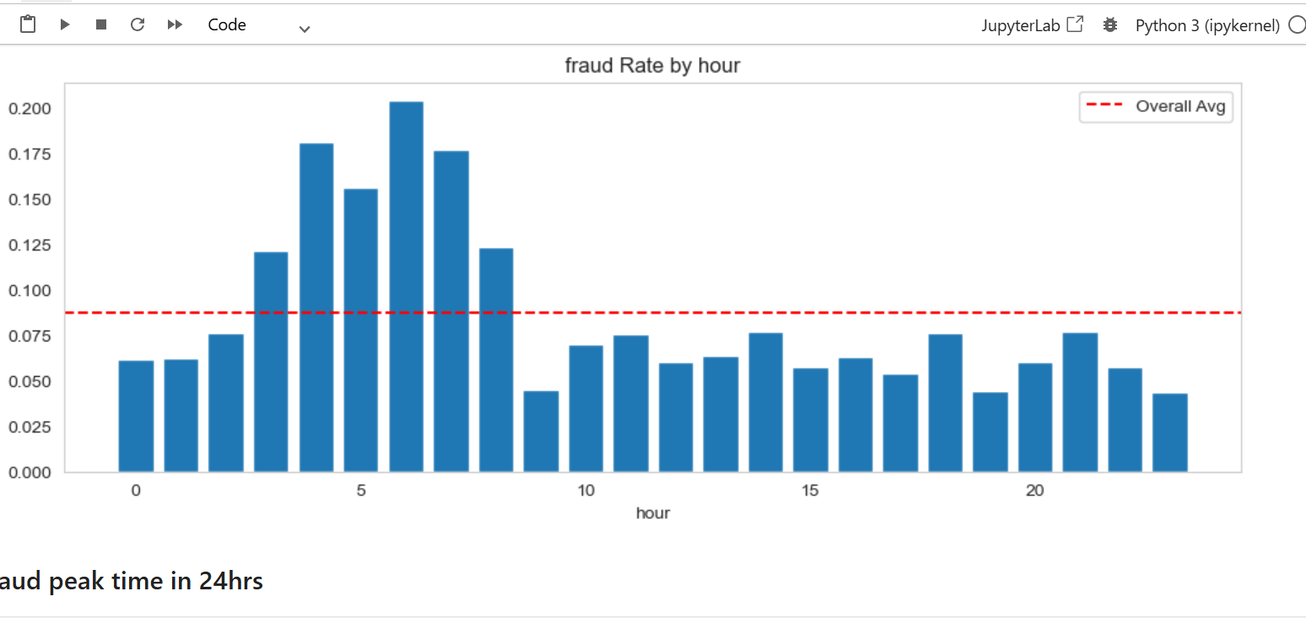
Fraud peak hours
Key Insights
7

Slide 11
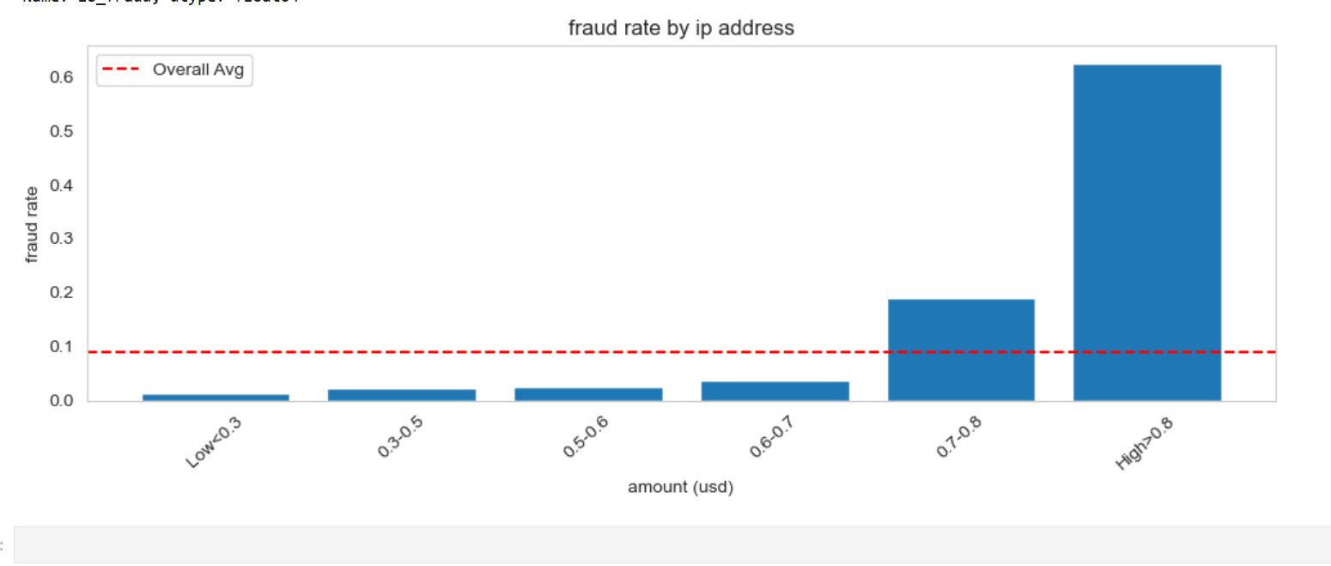


Device, Network & Identity Signals
Fraudulent transactions look sharply different from legitimate ones on device and network trust metrics.
Fraud Rate by IP Risk Tier
Median Score: Fraud vs. Legitimate
IP Risk Score
Legit: 0.306
Fraud: 1.000
Device Trust Score
Legit: 0.777
Fraud: 0.237
Key Insight
Fraudulent transactions almost always come from maximally risky IPs (median score 1.0) and untrusted devices (median 0.237) — device and network trust scores are near-perfect discriminators on their own.
NovaPay Fraud Detection | 08

Slide 12
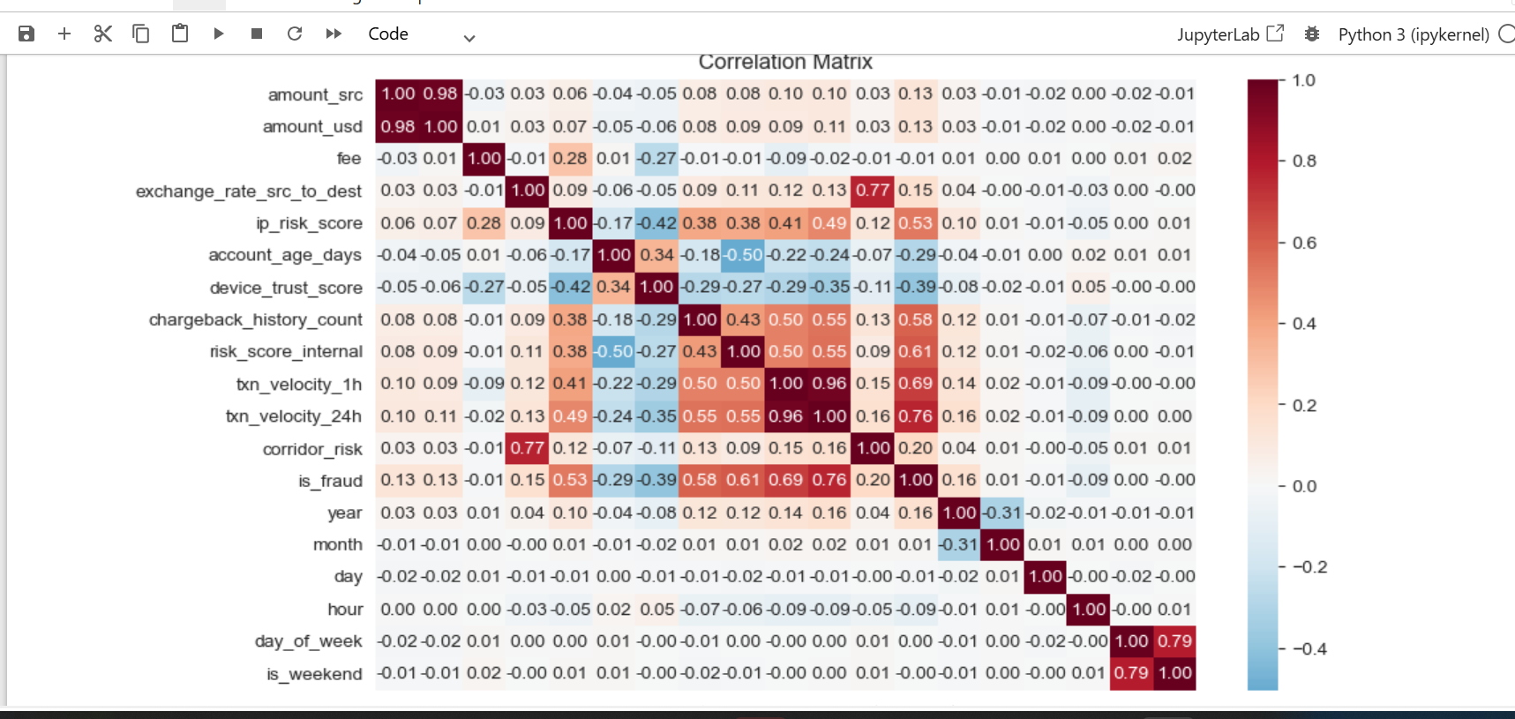
Fraudulent transactions almost always come from maximally risky IPs (median score 1.0) and untrusted devices (median 0.237) — device and network trust scores are near-perfect discriminators on their own.
NovaPay Fraud Detection | 08

Slide 13

Preparing Data for Modeling
Encoding, scaling, and correcting for severe class imbalance before training.
01
02
03
04
Encode
Scale
Balance (SMOTE)
Split
Label-encode 10 categorical fields (channel, currencies, kyc_tier, country, risk buckets)
StandardScaler applied to 12 numeric columns for comparable magnitude
Synthetic minority oversampling corrects the fraud/non-fraud imbalance
80/20 train-test split — 16,075 training rows, 4,019 test rows
Class Balance: Before vs. After SMOTE
Why it matters
Fraud made up only ~11.9% of raw transactions. Without correction, models default to predicting “not fraud” and miss real cases. SMOTE generates synthetic fraud examples so the model learns both classes equally.
NovaPay Fraud Detection | 09

Slide 14

Comparing 8 Classification Models
Every model was trained on the balanced dataset and evaluated on a held-out 20% test set (4,019 transactions).
Model | Accuracy | Precision (Fraud) | Recall (Fraud) | F1 (Fraud)
Random Forest | 0.99 | 1.00 | 0.98 | 0.99
XGBoost | 0.99 | 1.00 | 0.98 | 0.99
Gradient Boosting | 0.97 | 1.00 | 0.95 | 0.97
Decision Tree | 0.97 | 0.97 | 0.97 | 0.97
KNN | 0.96 | 0.93 | 1.00 | 0.96
AdaBoost | 0.95 | 0.97 | 0.92 | 0.95
Logistic Regression | 0.93 | 0.96 | 0.88 | 0.92
SVM | 0.92 | 0.99 | 0.85 | 0.92
Top Performer
Random Forest
Tied with XGBoost at 99% accuracy, but chosen for its interpretability, native feature importances, and lower tuning complexity in production.
Simpler models (Logistic Regression, SVM) trail by 6–7 points of F1 — the fraud signal here is non-linear.
NovaPay Fraud Detection | 10

Slide 15
Final Model: Tuned Random Forest
GridSearchCV (5-fold CV, optimizing F1) confirmed the default configuration was already near-optimal.
Best Hyperparameters
Test-Set Performance
n_estimators
200
99%
100%
max_depth
None
Accuracy
Precision (Fraud)
min_samples_split
2
min_samples_leaf
1
98%
99%
class_weight
balanced
Recall (Fraud)
F1-Score (Fraud)
Confusion Matrix (Test Set, n=4,019)
 | Pred: Legit | Pred: Fraud
Actual: Legit | 1,973 | 36
Actual: Fraud | 40 | 1,970
Only ~1.9% of transactions were misclassified in either direction — an excellent balance of catching fraud while minimizing false alarms that would burden the review team.
NovaPay Fraud Detection | 11

Slide 16
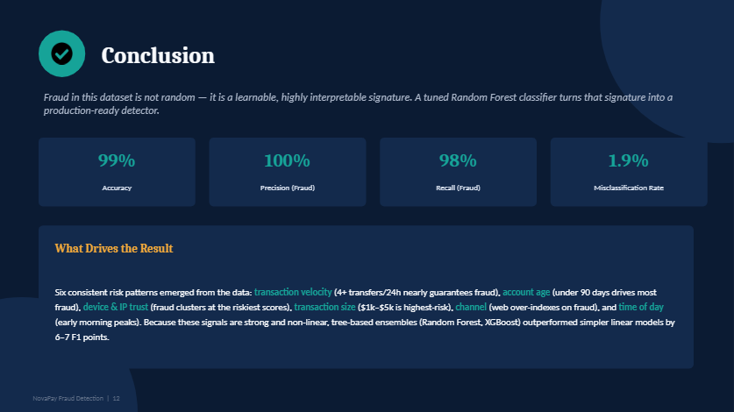
From Raw Logs to Real-Time Risk Scoring
A tuned Random Forest classifier reaching 99% accuracy and 99% F1-score on held-out fraud detection — built end-to-end from data cleaning through hyperparameter tuning.
Philip Ibingha | Data Scientist — Predictive Analytics & ML
github.com/philipibingha07-code
NovaPay Fraud Detection | 13

Slide 17


Business Recommendations
Translating model findings into concrete fraud-prevention actions for NovaPay.
Velocity-based real-time holds
Weight device & IP trust higher
Tighten controls for new accounts
Auto-flag any account with 4+ transactions in a rolling 24h window for step-up verification before completion.
Route transactions from low-trust devices or high-risk IPs (score > 0.7) into a manual review queue.
Apply lower transaction limits and extra checks for accounts under 90 days old, where fraud rate exceeds 35%.
Extra scrutiny at $1k–$5k
Monitor the early-morning window
Deploy the Random Forest model
This transfer band shows the highest fraud concentration — apply enhanced verification before release.
Increase automated review sensitivity between 4am–8am, when fraud rate is roughly 3x baseline.
Integrate the tuned classifier into the transaction pipeline as a real-time pre-authorization risk score.
NovaPay Fraud Detection | 12

